Slide 1


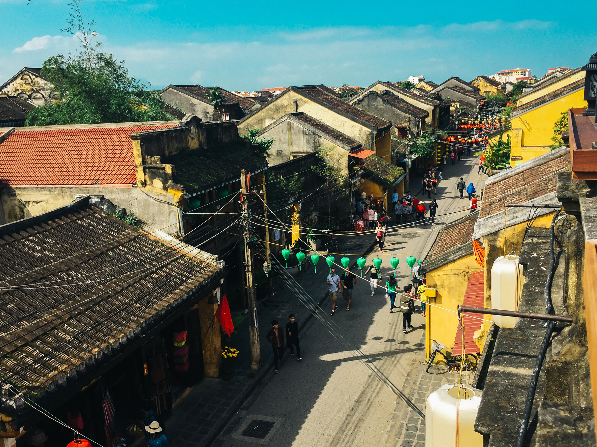

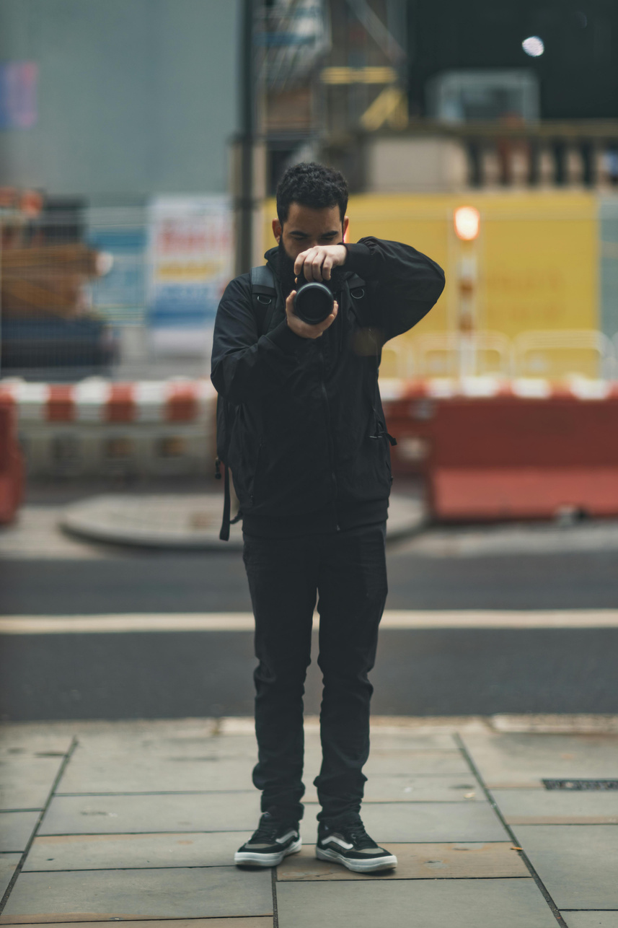

1
Custom travel + photography packages
2
Cinematic drone documentation services
3
Personalized travel photo albums
Product Snapshot
4
Destination-based curated portfolios

